Slide 1

Perturbation Feedback Approaches in Stochastic Optimal Control : Applications to Model-based and Model-free Problems in Robotics
Master’s thesis presentation
Karthikeya S Parunandi
Advisor : Dr. Suman Chakravorty
September 3, 2019

Slide 2
Sura-na Bheda Pramaana Sunaavo;
Bheda, Abheda, Pratham kara Jaano.
Show me that you can divide the notes of a song;
But first, show me that you can discern
Between what can be divided
And what cannot.
—An anonymous musical composition inspired by a classical Sanskrit poem
(From Siddhartha Mukherjee’s `The Gene: An Intimate History’)

Slide 3
Table of Contents
1
Introduction
Stochastic Optimal Control
Motion Planning in Robotics
Reinforcement Learning
2
Trajectory-optimized Perturbation Feedback Control (T-PFC)
3
Decoupled Data-based Approach for Learning to Control Nonlinear Systems (D2C)
4
A DDP-based Approach to Speed-Up D2C (D2C-2.0)

Slide 4
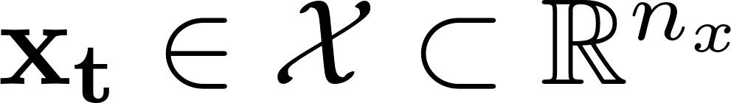
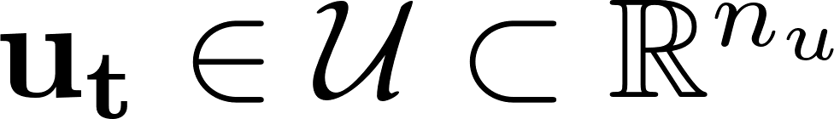
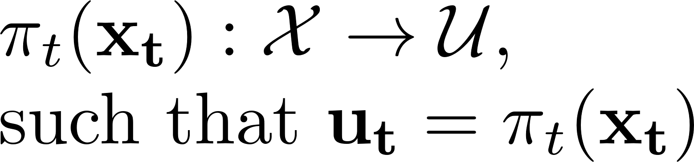
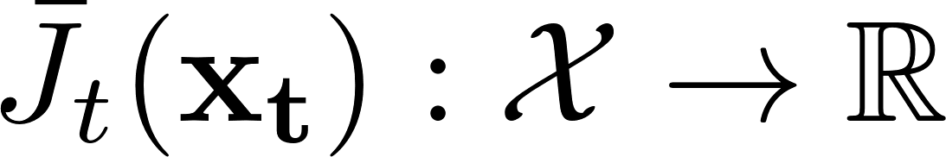
Introduction - Terminology
State at time-step t:
Control at time-step t:
Action policy at time-step t:
Incremental cost function at time-step t: Optimal state-action cost-to-go function at time-step t:
Optimal cost-to-go function at time-step t: Nominal trajectory for a horizon N:
Optimal nominal trajectory for a horizon N:

Slide 5
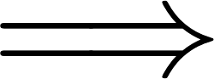
Introduction - Basic Assumptions
We consider discrete-time problems in continuous state and action spaces.
The cost function and the system model are smooth enough such that their requisite derivatives exist.
Fully-observed settings state is fully known at any given time.

Slide 6
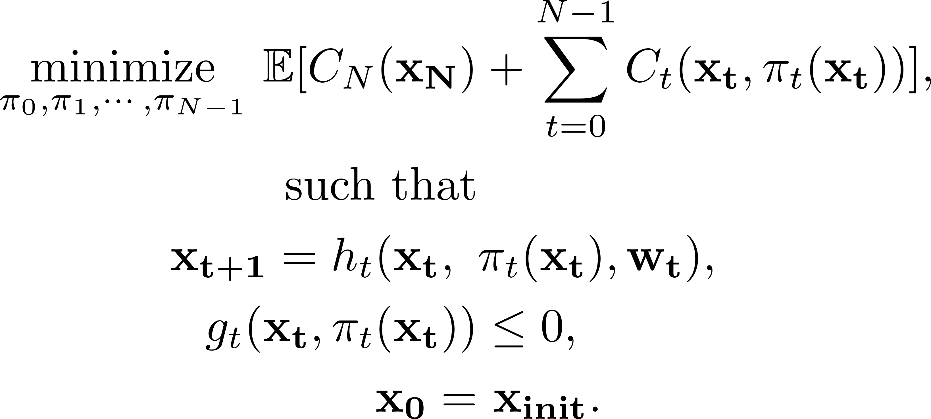
Introduction - Stochastic Optimal Control
Stochastic optimal control problem for a fully observed system [1][2]:
State model
Constraint
Initial condition

Slide 7
Introduction - Stochastic Optimal Control
Dynamic programming [1][2]:
Necessary to discretize the state-space.
Decision taken at every discretized grid-point.
As dimension of the state increases, the no. of discretization grid-points increase exponentially. This is the ‘curse of dimensionality’.

Slide 8
Introduction - Motion Planning in Robotics
Objective : To find a sequence of valid configurations for a robot to move from the source to destination.
Performed in a hierarchical manner [3].
Global path planning
Trajectory optimization
Local feedback control
Local path planning
Hierarchy of stages in motion planning

Slide 9
Introduction - Motion Planning in Robotics
Trajectory optimization:
Objective : To obtain a trajectory that minimizes cost while being compliant with the system model and other imposed constraints such as the actuator saturation, obstacle avoidance etc.
Lower-level stage of planning.
Popular approaches :
Iterative-LQR (ILQR)/Differential Dynamic Programming (DDP) [4][5], Direct transcription, MPC framework etc.

Slide 10
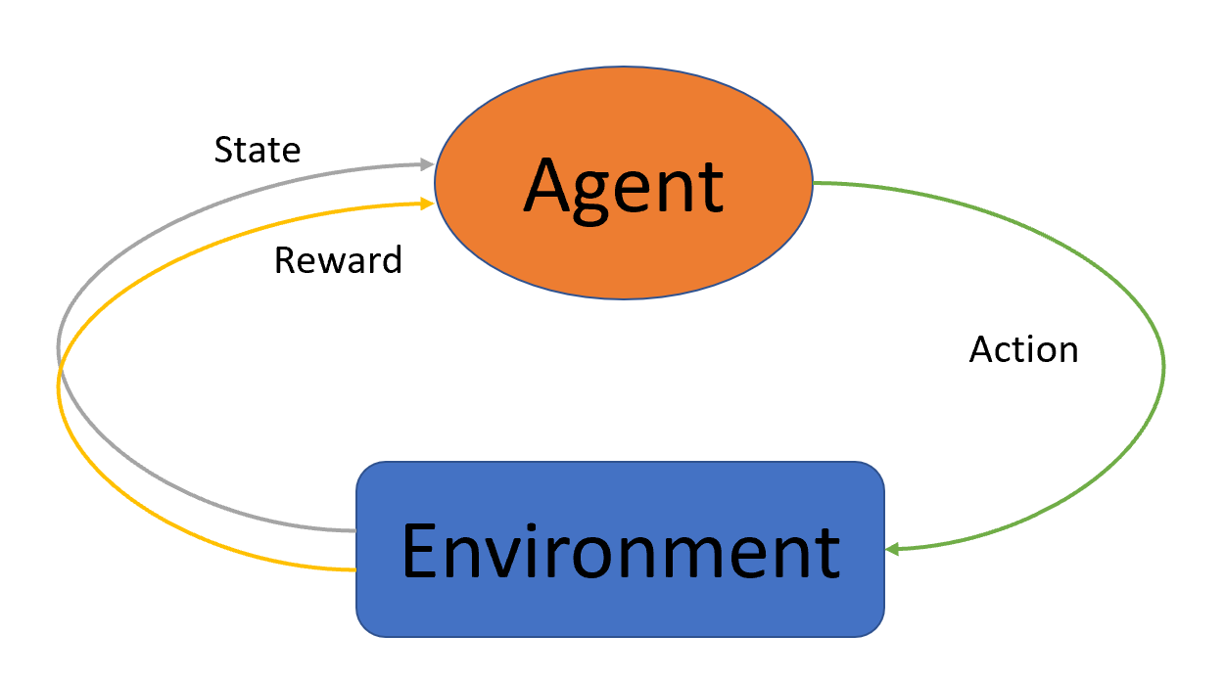
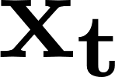

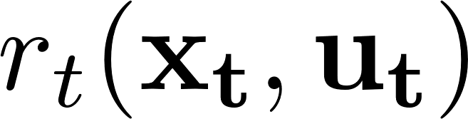
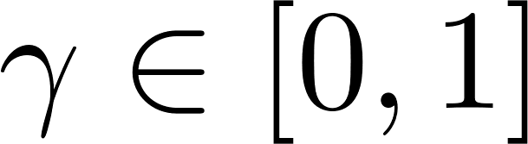
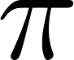
Introduction - Reinforcement Learning (RL)
Markov decision process:
Aims to solve the Markov Decision Process (MDP) – a
discrete-time stochastic control process that is a tuple of :
state - ,
action - ,
transition probability - ,
reward - ,
discount factor - .
Agent interacting with its environment
Look for a policy such that [6].

Slide 11
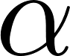
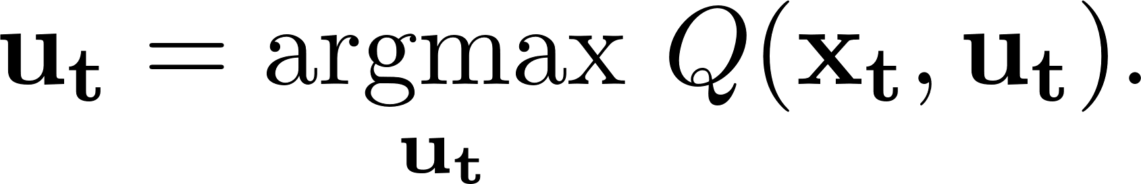
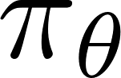

Introduction - Reinforcement Learning
Some important basic results in ‘Reinforcement Learning’:
Bellman optimality equation [6]:
Q-learning [6]:
where is the learning rate.
Policy gradient theorem [6]:
where is the policy parameterized by .

Slide 12
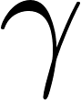
Introduction - Reinforcement Learning
Notable differences with stochastic optimal control:
Deals with data-based approaches.
The concept of ‘reward’ instead of ‘cost’.
Infinite horizon problem policy is time-invariant and is an important tuning factor.
Discrete-time stochastic control process.

Slide 13
Introduction - Motivation
Stochastic optimal control :
How to obtain a computationally tractable law?
How to overcome the ‘curse of dimensionality’?
Trajectory optimization in motion planning :
How to obtain online solutions?
How to cope-up with process noise?

Slide 14
Trajectory-Optimized Perturbation Feedback Control (T-PFC)
Collaborator : Dr. Suman Chakravorty

Slide 15
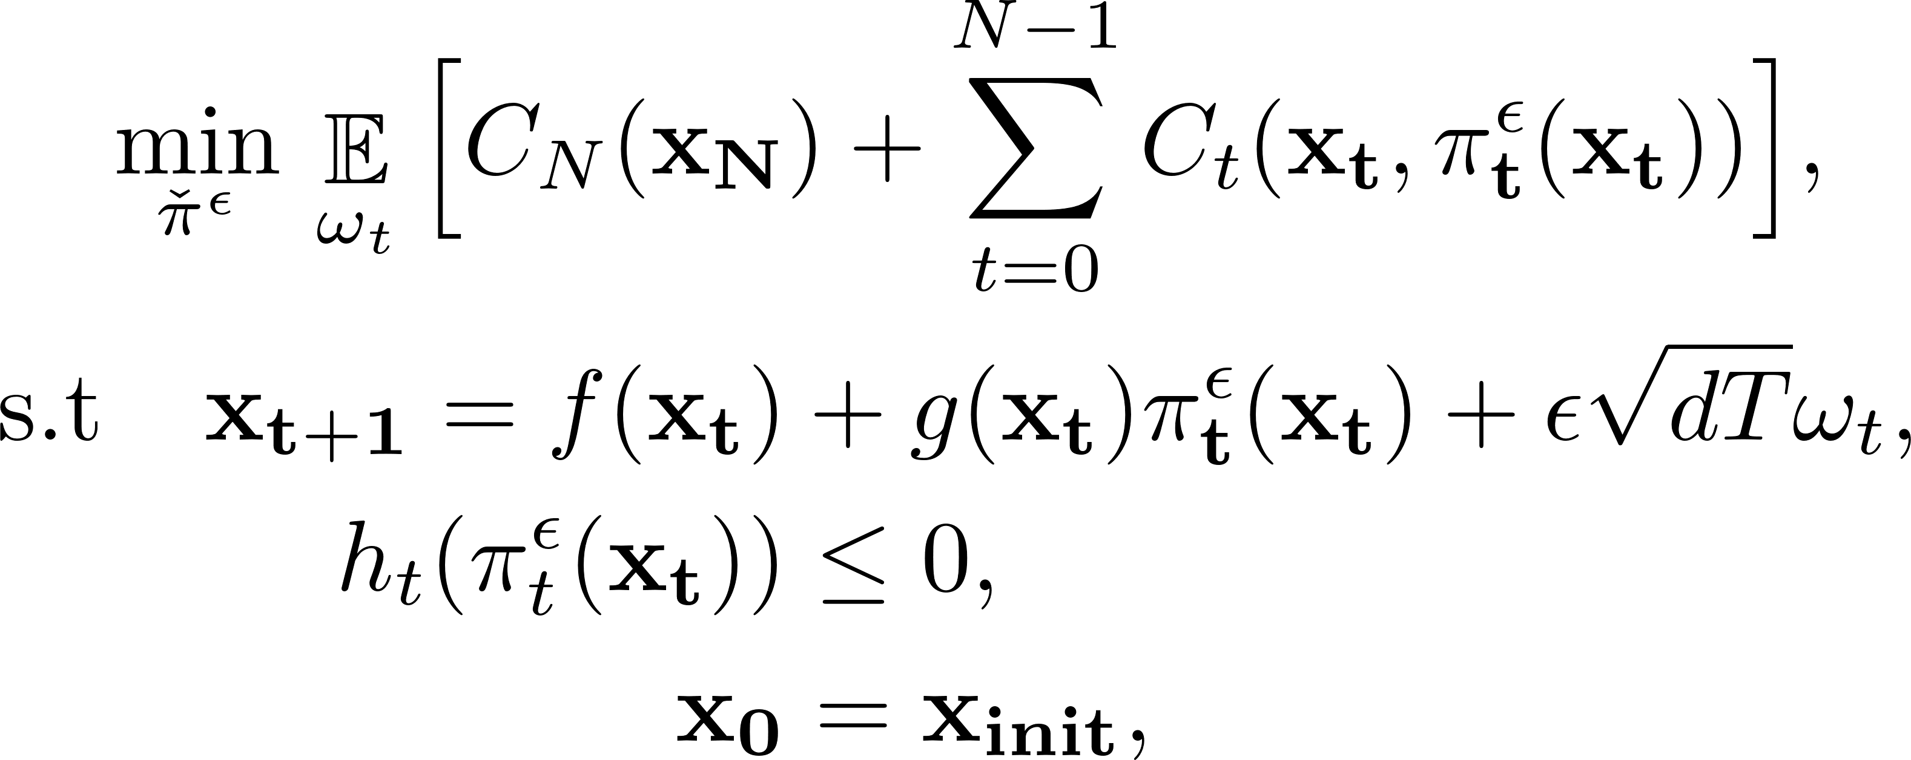
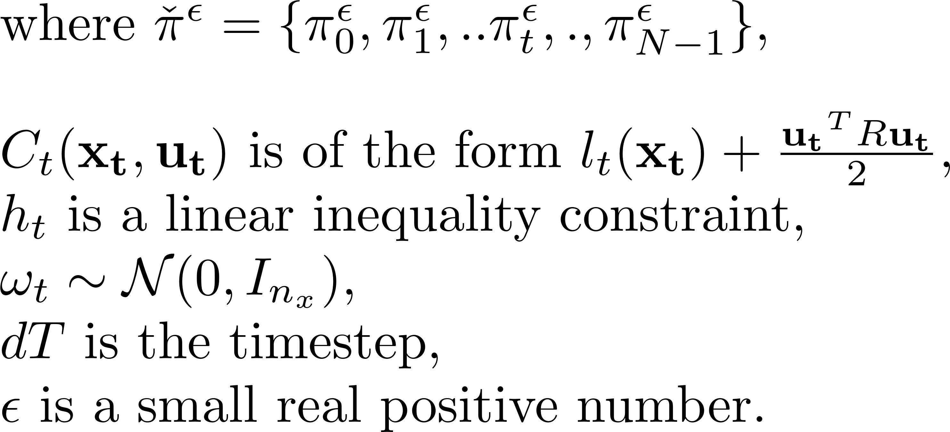
T-PFC - Problem Statement

Slide 16
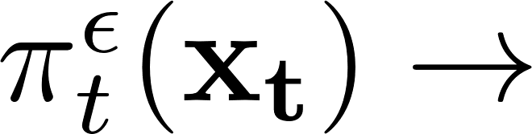
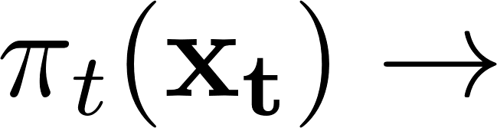
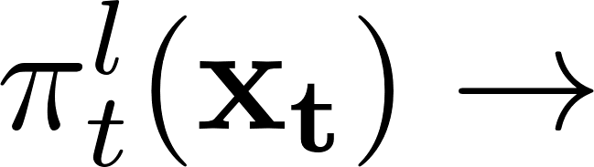
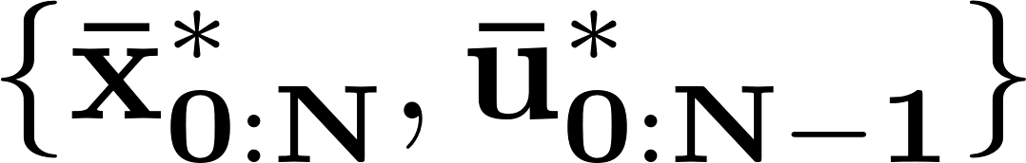
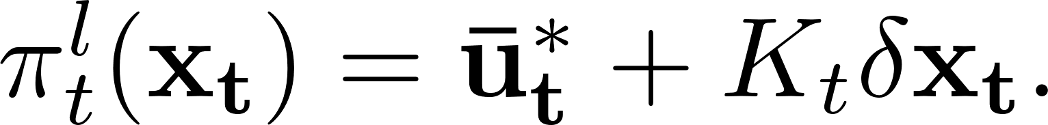
T-PFC - Terminology-1
True stochastic optimal policy.
Deterministic optimal policy obtained by assuming there’s no process uncertainty.
Truncated deterministic optimal policy obtained as follows.
Taylor’s expansion about the optimal nominal trajectory ,
Deterministic feedback law
Truncated deterministic
linear feedback law

Slide 17
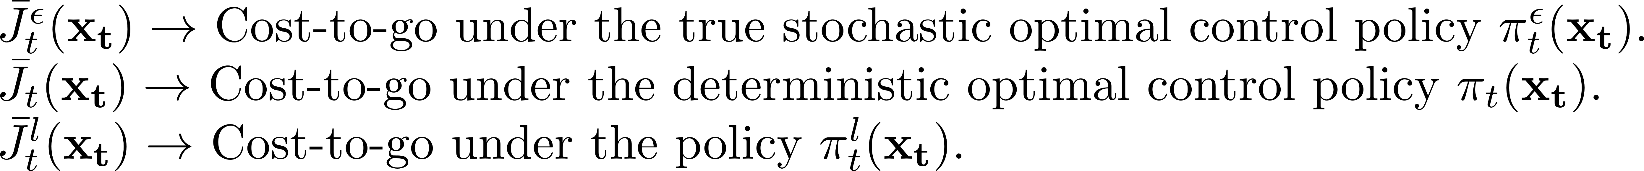
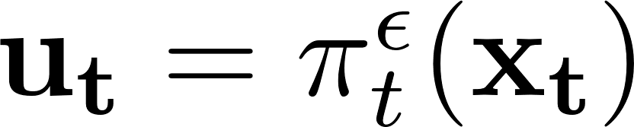
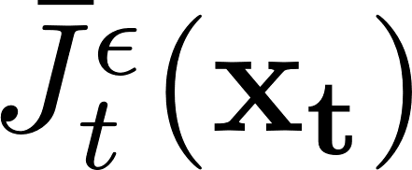
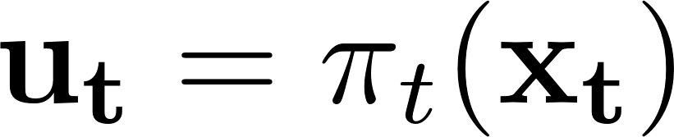
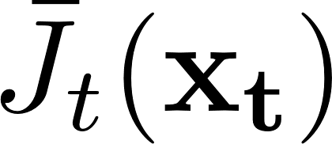
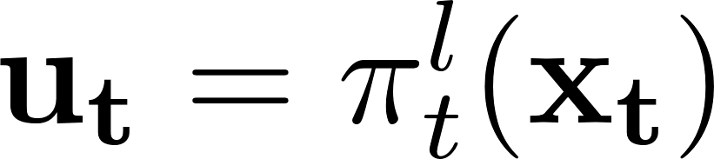
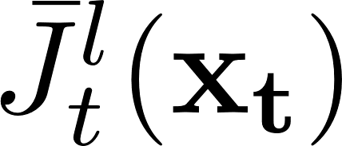
T-PFC - Terminology-2
Stochastic system

Slide 18
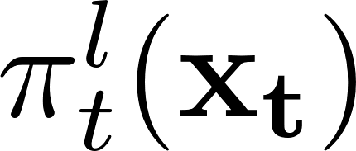
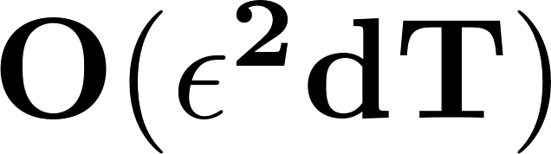
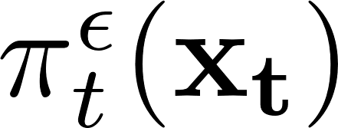
T-PFC - A Near-Optimal Decoupling Result
Proposition 1 : The performance of the truncated deterministic linear feedback law
is within of the stochastic optimal control law i.e,
We show the above using two arguments shown in the next slide.

Slide 19
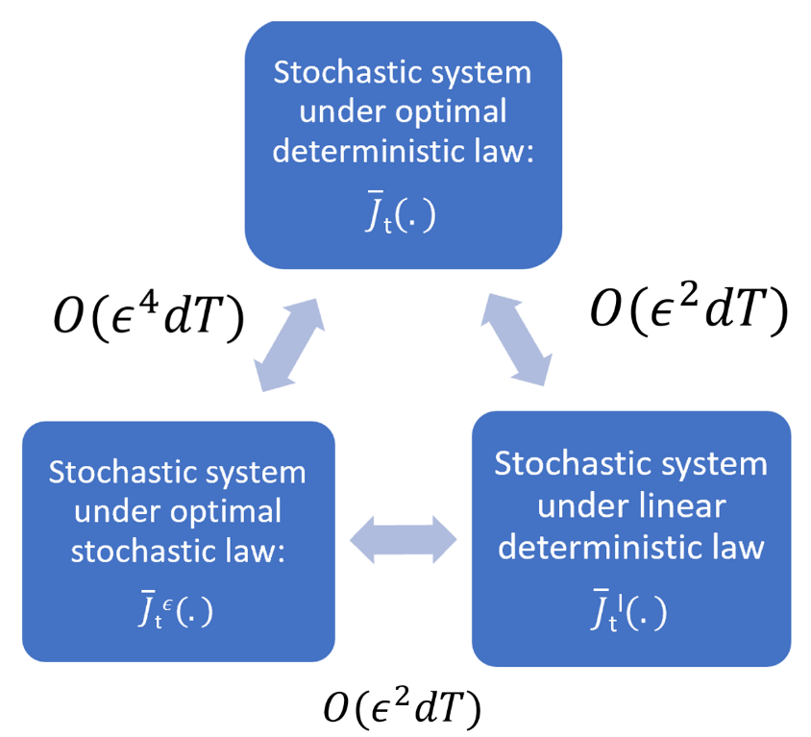
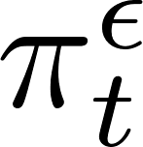
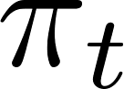
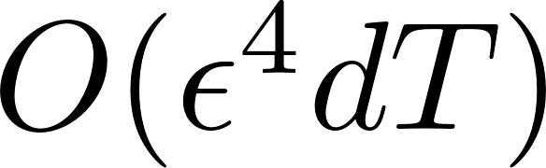
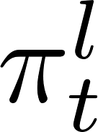
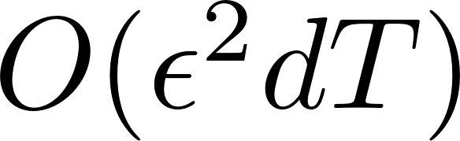
T-PFC - A Near-Optimal Decoupling Result
Argument 1 :
Fleming [7] showed that the difference in the performances under true stochastic optimal control law and that under the optimal deterministic law is when applied to a stochastic system.
Argument 2 :
The performance of the truncated deterministic linear law is within of the full deterministic feedback law when applied to a stochastic system.
From the above arguments, we have :
Near-Optimality

Slide 20
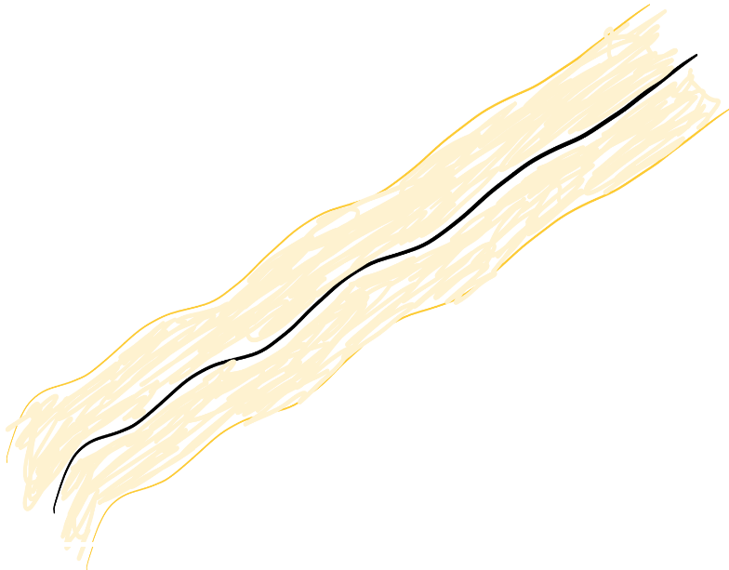
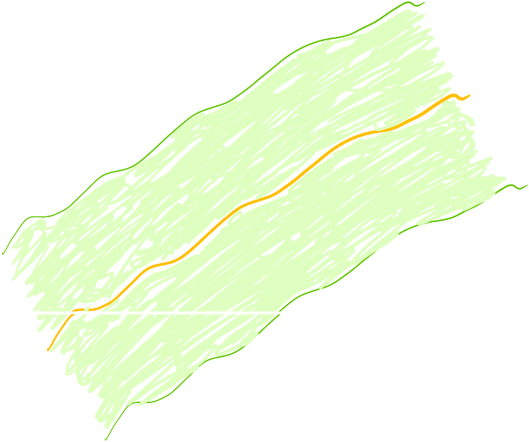
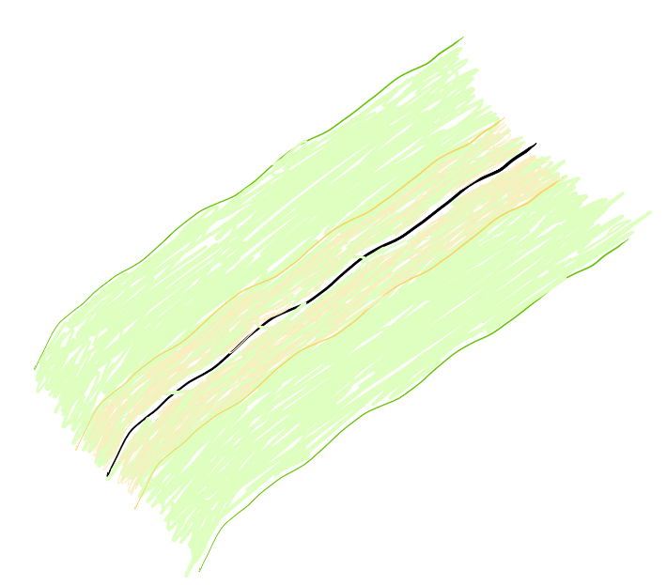
T-PFC - A Near-Optimal Decoupling Result
+
Performance of is within
of .
Performance of is within
of .
Performance of is within
of .

Slide 21
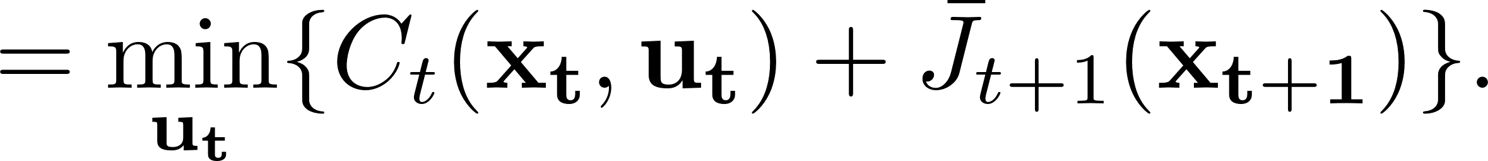
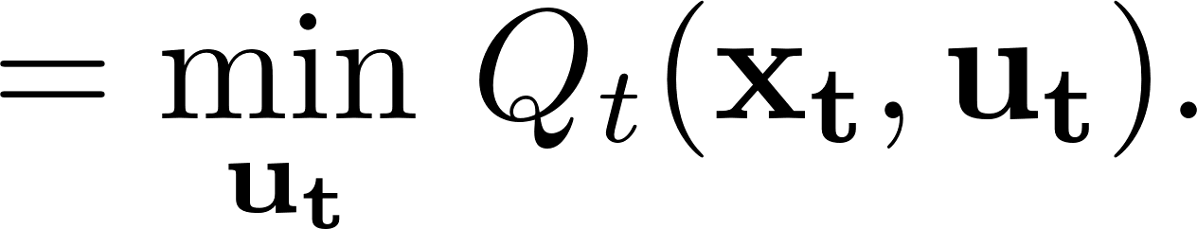
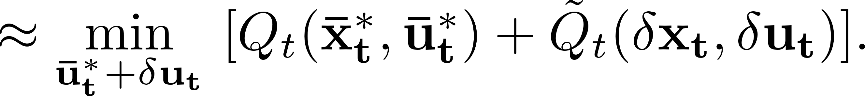
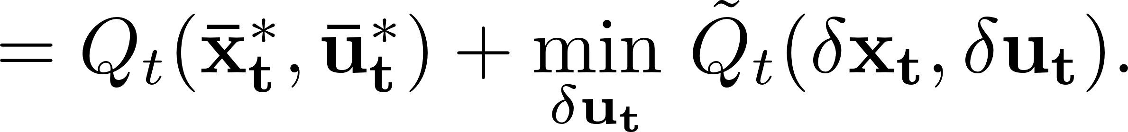
T-PFC - A Near-Optimal Decoupling Result
Objective : To determine the truncated deterministic linear feedback law .
+ H.O.T.
+ H.O.T.

Slide 22
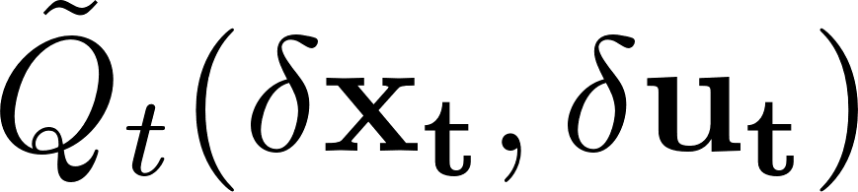
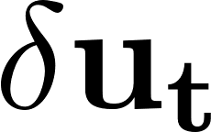
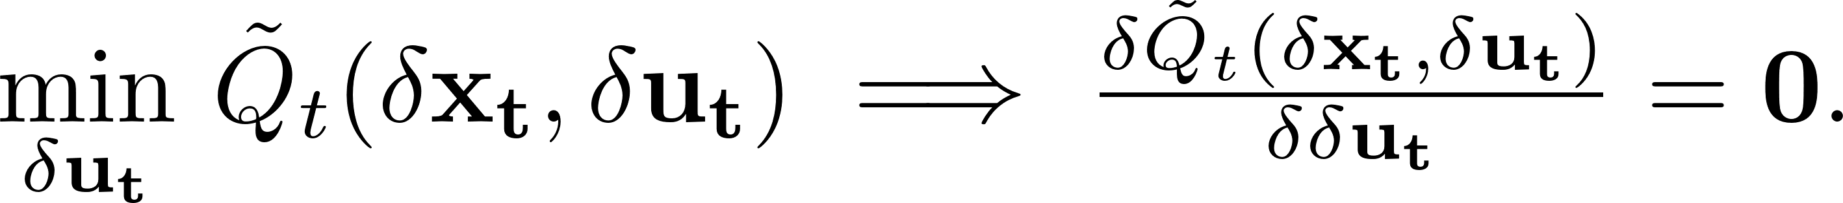
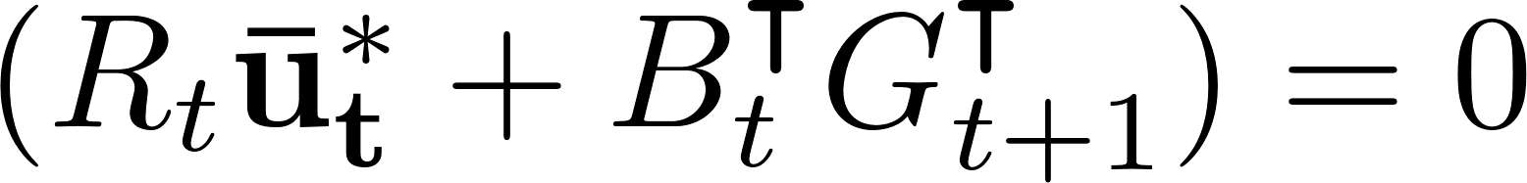
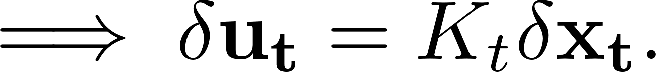

T-PFC - A Near-Optimal Decoupling Result
After expanding using Bellman equation and solving for in the above, we have:
But, from the Pontryagin’s minimum principle, we have .

Slide 23

T-PFC - A Near-Optimal Decoupling Result
Bellman equation
(on the optimal nominal trajectory)

Slide 24


T-PFC - A Near-Optimal Decoupling Result
Implication :
The truncated linear feedback law can be determined by :
Solving for the optimal nominal sequence first, and then
Designing a linear feedback law around the optimal nominal sequence.
The resultant law is near-optimal ( to ).

Slide 25



T-PFC - Algorithm
Step 1 : Solve for the optimal nominal trajectory as follows :
Step 2 : Solve for the linear feedback gains by recursively solving the following :
Step 3 : Resultant policy :

Slide 26




T-PFC - Example Applications - Robot Motion Planning
Following systems are considered :
Car-like robot :
State - .
Car-like robot with 2 trailers attached :
State - .
Quadrotor :
State - .
Initial and final states for motion planning. Position is in meters.

Slide 27


T-PFC - Example Applications - Robot Motion Planning
Open-loop trajectory
System’s trajectory
Motion planning of a car-like robot under noise injected through control
channel.

Slide 28

T-PFC - Example Applications - Robot Motion Planning
Open-loop trajectory
System’s trajectory
Motion planning of a car-like robot with trailers attached under noise
injected through control channel.

Slide 29



T-PFC - Example Applications - Robot Motion Planning
Motion planning of a quadrotor under noise injected through control
channel.

Slide 30



T-PFC - Example Applications – Simulation Results
Plots illustrating the avg. costs incurred for motion planning with increasing noise levels :
1) Car-like robot.
2) Car-like robot with 2 trailers attached.
3) Quadrotor.

Slide 31


T-PFC - Example Applications – Simulation Results
Comparison of avg. run-time with T-LQR, ILQG and NMPC.
Re-planning frequency comparison :
Avg. no. of re-plannings for NMPC = N-1 = 228.
Re-planning frequency with increasing noise in T-PFC

Slide 32
T-PFC - Limitations
Agnostic to noise/uncertainty - more noise mandates frequent re-planning.
Assumptions such as :
Control-affine model, and
Constraint only linear in controls.
Heavily dependent on system model :
What if the model is not accurate?
What if the ignored environmental effects are significant?
What if the system model is difficult to construct?

Slide 33

T-PFC - Motivation for Model-Free Approaches
Environment : Static fluid with arbitrary viscosity
System : Fish that can move its torso using its fins and tail
Task : Swim the Fish into the ball
State dimension : 27
Control dimension : 5
Simulator : MuJoCo

Slide 34
Decoupled Data-Based Approach for Learning to Control Nonlinear Systems (D2C)
Collaborators : Ran Wang, Dr. Dileep Kalathil and Dr. Suman Chakravorty.

Slide 35
Decoupled Data-based Approach (D2C)
Based on the same near-optimal decoupling principle used in T-PFC.
The control policy comprises of (i) an open-loop sequence and (ii) a linear feedback law, that can be determined individually, in a decoupled fashion.
The open-loop control sequence combined with the linear feedback law wrapped around it constitutes the policy.

Slide 36
Decoupled Data-based Approach (D2C)
Algorithm :
Solve for the open-loop control sequence by using information from multiple episodes of the system in a simulator followed by gradient descent.
Linearize the system around the optimal nominal trajectory and perform the system identification for the resultant LTV system.
Design an LQR to track the optimal nominal control sequence.
The linear feedback law combined with the open-loop control sequence constitutes the policy.

Slide 37


D2C - Policy Design
Open-loop design:
Feedback design:

Slide 38


D2C - Policy Design – Open-Loop
Shooting method parameterized by a control sequence.
Control sequence in the trajectory at iteration: .
Perform gradient descent to determine the optimal control sequence.
where

Slide 39




D2C - Policy Design – Gradient Estimation in Open-Loop
Gradients are estimated by sequentially averaging as follows, using multiple trajectory rollouts such that rollout is , where .

Slide 40



D2C - Policy Design – Closed-Loop
Linear system equation
or
Linear system equation
for multiple samples

Slide 41


D2C - Policy Design – Closed-Loop
Least square by stochastic approximation

Slide 42


D2C - Comparison with DDPG
Deep Deterministic Policy Gradients (DDPG) [7]:
Policy gradient-based reinforcement learning algorithm for continuous action spaces.
Actor-critic architecture :
Critic network estimates the value given the state and the action.
Actor network generates an action given the state i.e, represents the policy .
Deep neural networks are used to represent both the actor and the critic networks.
Combination of Q-learning and policy gradients.

Slide 43





D2C - Comparison with DDPG
Deep Deterministic Policy Gradients (DDPG) :
Critic network - trained using Q-learning
Q function is represented by a neural network no guarantees on the convergence.
Experience replay.
Target network.
Critic network
Actor network – trained using policy gradients
Actor network
Actor-critic architecture in DDPG

Slide 44
D2C - Comparison with DDPG
Different formulations. How to make a fair comparison?
D2C | DDPG
1) Solves a finite-horizon problem. | 1) Solves an infinite-horizon problem.
2) Terminal cost plays a major role in accurately reaching the goal. | 2) No concept of terminal reward.
3) Looks for a perturbation feedback solution about a locally-optimal nominal sequence. | 3) Looks for a globally-optimal global feedback policy.

Slide 45
D2C - Comparison with DDPG
Measures taken to make the comparison fairer :
Solve with the cost/reward functions that result in best performances for each of the algorithms.
Time-budget in the form of time-horizon is imposed both for training and testing.
Train the algorithms for local feedback policy.

Slide 46


D2C - Example 1 : Pendulum Swing-up
D2C (credit : Ran Wang)
DDPG

Slide 47


D2C - Example 2 : Cart-pole Swing-up
D2C (credit : Ran Wang)
DDPG

Slide 48


D2C - Example 3 : Motion Planning of a 6-link Swimmer
D2C (credit : Ran Wang)
DDPG

Slide 49
D2C - Comparison with DDPG
Performance comparison on three aspects:
Data-efficiency in training :
The no. of training samples and data storage required for the algorithm.
Robustness to noise :
The deviation from the task due to random noise during testing.
Ease of training :
Challenges involved in training.

Slide 50




D2C - Comparison with DDPG - Training Plots
Simple pendulum
Cartpole
D2C (credits : Ran Wang)
DDPG

Slide 51




D2C - Comparison with DDPG - Training Plots
3-link swimmer
6-link swimmer
D2C (credits : Ran Wang)
DDPG

Slide 52


D2C - Comparison with DDPG - Testing Plots
Pendulum Swing-up (Credit : Ran Wang for D2C)
Cartpole Swing-up (Credit : Ran Wang for D2C)

Slide 53
D2C - Conclusion out of the Comparison with DDPG
Data efficiency :
Reflected in the time-taken for training the policies.
D2C learns its policy substantially faster than DDPG better data efficiency.
Robustness to noise :
No precise trend observed as to which algorithm is more robust.
For higher levels of noise, in most systems, DDPG performed better.
The influence of the terminal cost in D2C cannot be ignored.
Ease of training :
D2C has great advantage here over DDPG.
Challenges of DDPG and most canonical RL algorithms :
No guarantees for convergence.
Reproducibility is a major challenge.
Overwhelming number of hyperparameters to tune.

Slide 54


D2C - Comparison on Reproducibility
Training plots averaged over multiple (5) episodes of training with the 3-link swimmer :
D2C (Credit : Ran Wang)
DDPG

Slide 55
Model-free DDP based D2C (D2C – 2.0)
Collaborator : Dr. Suman Chakravorty

Slide 56
D2C – 2.0
An important observation from D2C :
Open-loop training substantially more computationally intensive than that of the feedback law.
Gradient descent is first-order converging and too generic to solve any optimization
Solution?
Investigate a second-order method - DDP.
Originally proposed by 1966 by D.Q. Mayne [9].
Revived in early 2000s due to an important modification by ILQR [4][5].

Slide 57


D2C – 2.0 - Differential Dynamic Programming (DDP)
An indirect shooting method.
Original trajectory optimization problem:
Intuition of DDP :
Iteratively solve the above until convergence

Slide 58




D2C – 2.0 - Differential Dynamic Programming (DDP)

Slide 59

D2C – 2.0 - Differential Dynamic Programming (DDP)

Slide 60
D2C – 2.0 - Differential Dynamic Programming (DDP)
Some important observations :
The algorithm is explicit in terms of the system model and its derivatives.
The second derivatives are not required (in ILQR) :
In fact, ignoring them gives a faster solution.
They are compensated by incorporating regularization and line search into the algorithm.
Significantly faster convergence in the episodic cost than gradient descent-based approaches.

Slide 61


D2C – 2.0 - Estimation of Jacobians in a Model-free Fashion

Slide 62


D2C – 2.0 - Estimation of Jacobians in a Model-free Setting

Slide 63





D2C – 2.0 - Example Applications - Training plots
(a)
(b)
(c)
Systems:
Pendulum.
Cartpole.
3-link swimmer.
6-link swimmer.
Fish.
(d)
(e)

Slide 64

D2C – 2.0 - Comparison with D2C and DDPG

Slide 65
Conclusion
The near-optimal decoupling principle made the problem computationally tractable by reducing the problem complexity.
Applications of the principle in model-free and model-based scenarios are presented.
T-PFC is a model-based deterministic linear feedback law that :
Is near-optimal.
Is robust to low to medium levels of noise.
Significantly reduced the computational requirement and hence, the algorithmic runtime.
D2C is also near-optimal model-free algorithm that :
Is sample-efficient as compared to a state-of-the-art RL algorithm.
Is scalable to higher dimensional systems.
Offers reproducible results, which is currently lacking in mainstream RL [10].
D2C - 2.0 significantly reduced the time-taken to solve the open-loop sequence in all the examples, in comparison with D2C.

Slide 66
Conclusion
Sura-na Bheda Pramaana Sunaavo;
Bheda, Abheda, Pratham kara Jaano.
Show me that you can divide the notes of a song;
But first, show me that you can discern
Between what can be divided
And what cannot.
—An anonymous musical composition inspired by a classical Sanskrit poem
(From Siddhartha Mukherjee’s `The Gene: An Intimate History’)

Slide 67
Thank you !
Special thanks to Roshan, Utkarsh, Naveed and Woosang for their valuable feedback and comments on the presentation.

Slide 68
References:
P. R. Kumar and P. Varaiya, Stochastic systems: Estimation, identification, and adaptive
control, vol. 75. SIAM, 2015.
2) D. P. Bertsekas, Dynamic programming and stochastic control. Academic Press, 1976.
3) S. Waslander, J. Kelly, Motion planning for self-driving cars, Coursera, 2019.
4) W. Li and E. Todorov, “Iterative linear quadratic regulator design for nonlinear biological
movement systems,” International Conference on Informatics in Control, Automation and
Robotics, vol. 1, pp. 222–229, 2004.
5) E. Todorov and W. Li, “A generalized iterative lqg method for locally-optimal feedback control
of constrained nonlinear stochastic systems,” in American Control Conference, pp. 300–306, 2005.
6) R. S. Sutton and A. G. Barto, Reinforcement learning: An introduction. MIT press, 2018.
7) W. H. Fleming, “Stochastic control for small noise intensities,” SIAM Journal on Control and
Optimization, vol. 9, pp. 473–517, 1971.
8) T. P. Lillicrap, J. J. Hunt, A. Pritzel, N. Heess, T. Erez, Y. Tassa, D. Silver, and D. Wierstra,
“Continuous control with deep reinforcement learning,” arXiv preprint arXiv:1509.02971, 2015.
9) D. Q. Mayne, ‘‘A Second-order Gradient Method for Determining Optimal Trajectories of Non-linear Discrete-time Systems, International Journal of Control’’, vol. 3:1, pp. 85-95, 1966.
10) M. G. D. P. Riashat Islam, Peter Henderson, “Reproducibility of benchmarked deep reinforcement learning tasks for continuous control,” Reproducibility in Machine Learning Workshop, ICML, 2017

Slide 69
Supplementary Slides

Slide 70




Introduction - Motion Planning in Robotics
Path planning:
Objective : To find a collision-free path that will drive the robot between two points.
Higher level planning.
Requires a map of the environment.
Popular algorithms :
Continuous maps - RRT, RRT*, Kinodynamic RRT for nonholonomic systems etc.
Occupancy grid maps - Dijkstra, A* etc.
Rapidly exploring Random Tree (RRT)
Dijkstra’s algorithm
A* algorithm

Slide 71
T-PFC

Slide 72
D2C

Slide 73


Comparison with DDPG – Training Plots – Neural Network Loss
Simple Pendulum
Cartpole

Slide 74

Comparison with DDPG – Training Plots – Neural Network Loss
3-link swimmer

Slide 75


Comparison with DDPG - Testing Plots

